Slide 1
Structure of a Python programme written to run with pgzrun
#=================================
# Declaration of global variables
#=================================
# Function update
def update():
# indented code
#=================================
# Function draw
def draw():
# indented code
This is the section where variables are created – like WIDTH, HEIGHT, speed, or the rectangle objects to use in the game.
These variables are made outside of any function so they are global variables.
Python will carry out all the instructions in this section before running the code in the functions.
This section contains all the instructions which will change the variables – eg change the position variables, test for collisions, check if any key is being pressed etc.
This function is automatically run by Pygame Zero 60 times every second.
This section contains all the instructions for drawing things inside the window.
This function is automatically run by Pygame Zero immediately after function draw, 60 times every second.

Slide 2
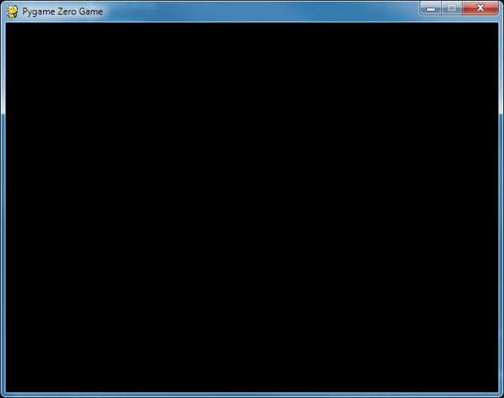
How to position a rectangle or textbox
topleft
midtop
topright
midleft
center
midright
topleft
midtop
topleft
topright
midtop
topright
bottomleft
midbottom
bottomright
midleft
center
midleft
midright
center
midright
bottomleft
midbottom
bottomleft
midbottom
bottomright
bottomright
Random position
x = 220, y = 105
topleft
midtop
topright
midleft
center
midright
bottomleft
midbottom
bottomright
screen.draw.rect(box, midbottom=(220, 105))
screen.draw.rect(box, topright=(220, 150))
screen.draw.rect(box, (220, 150))

Slide 3
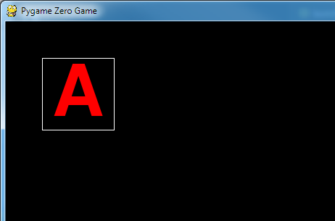
How the text is placed in a textbox (1)
A textbox is a Rectangle containing text sized to fill the rectangle
Make rectangle called box
left edge at x coord 50
top edge at y coord 50
width 100 pixels
height 100 pixels
Draw letter A in the rectangle called box
box = Rect(50, 50, 100, 100)
def draw():
screen.draw.textbox('A', box, color=(255,0,0))
screen.draw.rect(box, color='white')
Draw the rectangle called box with a white outline

Slide 4
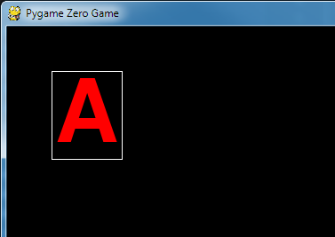
How the text is placed in a textbox (2)
A textbox is a Rectangle containing text sized to fill the rectangle
Make rectangle called box
left edge at x coord 50
top edge at y coord 50
width 80 pixels
height 100 pixels
Draw letter A in the rectangle called box
box = Rect(50, 50, 80, 100)
def draw():
screen.draw.textbox('A', box, color=(255,0,0))
screen.draw.rect(box, color='white')
Draw the rectangle called box with a white outline

Slide 5
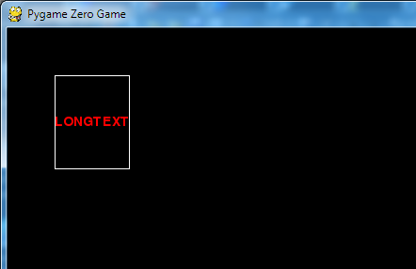
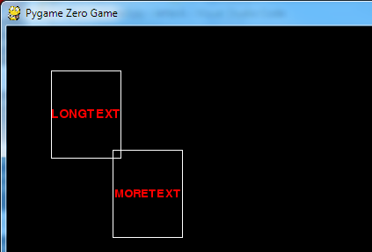
How the text is placed in a textbox (2)
A textbox is a Rectangle containing text sized to fill the rectangle
Make rectangle called box
left edge at x coord 50
top edge at y coord 50
width 80 pixels
height 100 pixels
Draw many letters in the rectangle called box
box = Rect(50, 50, 80, 100)
def draw():
screen.draw.textbox('LONGTEXT', box, color=(255,0,0))
screen.draw.rect(box, color='white')
Draw the rectangle called box with a white outline
MAKE THE SHAPE OF THE TEXTBOX MATCH THE SHAPE OF THE WORD

